Slide 1
Chapter 8: The musculoskeletal system allows movement

Slide 2
8.1 Types of muscles
Types of muscles
There are three types of muscle:
Skeletal muscles move bones and enable us to walk, run and carry out a wide range of voluntary physical activities. These muscles are under conscious control and are attached to the bones of the skeleton. They also give the body its form and contours, and allow it to maintain posture.
Smooth muscles, or involuntary muscles (not under conscious control), control movement within internal organs such as the stomach and intestines.
Cardiac muscle is heart muscle; When cardiac muscle contracts, it reduces the space in the chambers of the heart and pushes the blood from the heart into the blood vessels.
The properties of contractibility, extensibility and elasticity allows muscles to work together to create movement.

Slide 3
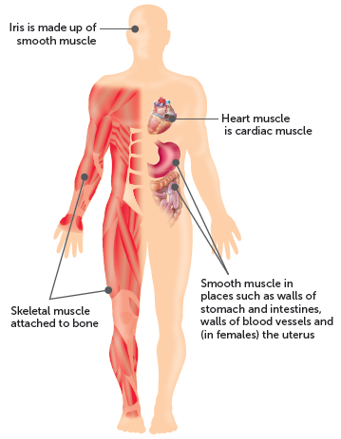
8.1 Types of muscles

Slide 4
8.2 Structure of skeletal muscle
Structure of skeletal muscle
Muscle cells are held together in bundles.
A sheath of connective tissue called the perimysium surrounds each bundle so that it can function as an individual unit.
The connective tissue allows adjacent bundles to slide easily over one another as they contract.
Sheaths of connective tissue called epimysium also hold the bundles together, and towards the end of the muscle they taper and blend to form the tendon.

Slide 5
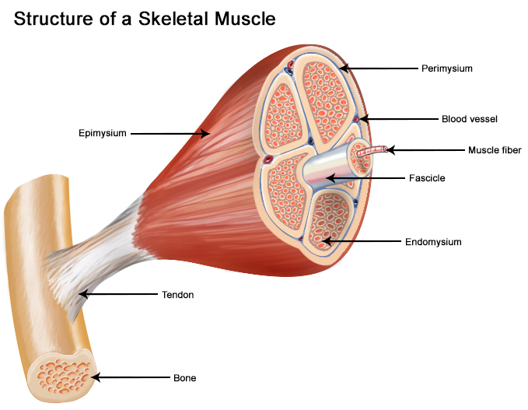

Slide 6
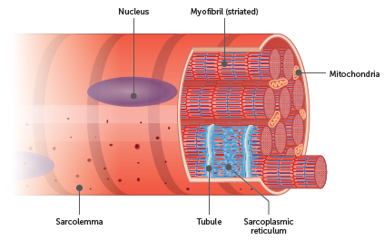
8.2 Structure of skeletal muscle
Structure of skeletal muscle fibres
Muscle bundles are composed of muscle cells that lie parallel to each other. Each muscle cell, called a muscle fibre, is an elongated cylinder with many nuclei. Around the cell is a thin, transparent plasma membrane, the sarcolemma, containing cytoplasm, called the sarcoplasm. Cells are between 10 and 100 micrometres in diameter and vary in length from a few millimetres to several centimetres.

Slide 7
8.2 Structure of skeletal muscle
Structure of myofibrils
Within the sarcoplasm of each fibre are thread-like myofibrils. These lie parallel to each other and run the length of the fibre. There may be anywhere from hundreds to several thousands of these myofibrils in each fibre. A tubular network called the sarcoplasmic reticulum surrounds the myofibrils. This is a storage site for calcium ions, which are released during muscle contractions.
Each myofibril is composed of many smaller myofilaments, made of protein, which are the actual units involved in contraction of the muscle. There are two types of myofilaments:
thick myofilaments, composed mainly of the protein myosin
thin myofilaments, composed mainly of the protein actin.
The arrangement of thick and thin filaments within a myofibril gives a banded effect to the muscle. These striations allow myofibrils to be divided into units called sarcomeres.
Notes:
<insert diagram – reuse Fig 8.6, p. 196, Human Perspectives ATAR Units 1 & 2, 8e, 9780170449090>

Slide 8
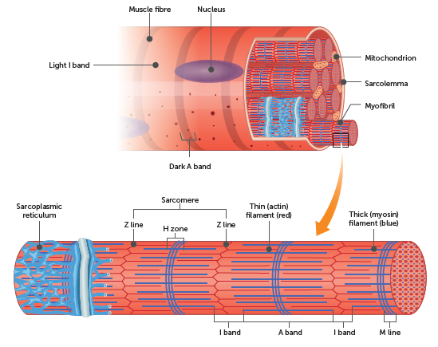
8.2 Structure of skeletal muscle

Slide 9
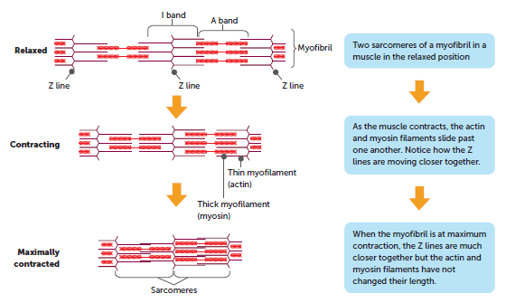
8.3 How muscles work
Sliding filament theory
When muscles contract, the sarcomeres shorten. The sliding filament theory suggests that this occurs because the actin and myosin filaments slide over one another.

Slide 10
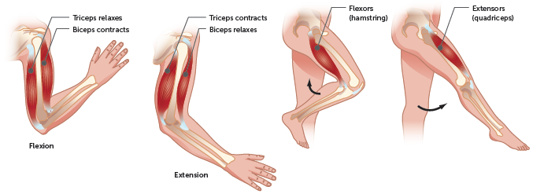
8.3 How muscles work
Skeletal muscles working together
Muscles are attached to the bones of the skeleton by fibrous, inelastic connective tissue called tendons.
Muscles work in pairs, with the muscles fulfilling opposite roles. Coordination of the paired muscles provides body movement, with one of the pair producing movement of bones in one direction and the other producing movement in the opposite direction (agonists).
Biceps and triceps muscles in the arm and hamstring and quadriceps muscles in the leg are agonistic muscles

Slide 11
8.3 How muscles work
Muscle tone
Muscle tone is maintaining partial contraction of skeletal muscles. At any one time, some muscle fibres are contracted while others are relaxed. Such partial contraction tightens a muscle, but not enough fibres are contracting at the one time to produce movement. Muscle tone is caused by many different fibres taking turns to contract. The fibres relieve one another so smoothly that the contraction can be kept up for long periods of time.
Muscle tone holds many of our body parts in position. For example, the head is held up by the partial contraction of the neck muscles. It determines a person’s posture.

Slide 12
8.4 Overview of the skeletal system
The skeletal system is made up of the bones and their associated structures: tendons, ligaments and joints.
Functions of the skeleton
Provides a scaffold to support the weight of the rest of the body.
Facilitates movement by being points of attachment for muscles.
Protects vital internal organs.
Produces red blood cells.
Stores and releases minerals and fats.

Slide 13
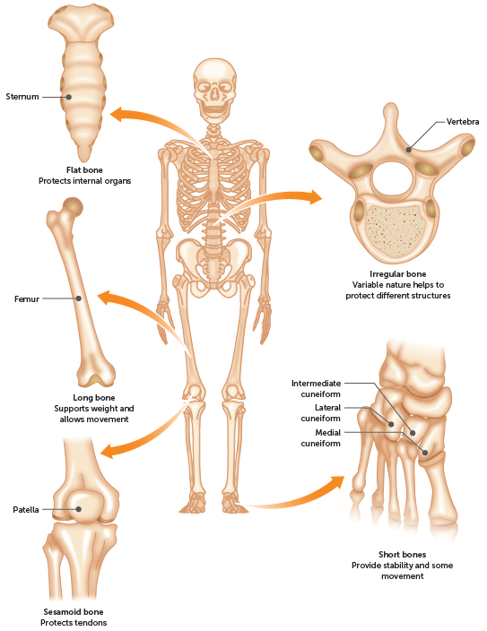
8.4 Overview of the skeletal system
Types of bone

Slide 14
8.4 Overview of the skeletal system
Bones of the skeleton
The adult human skeleton is usually made up of 206 individual bones. These are divided into two sections:
The axial skeleton consists of the bones that lie around the central axis of the body. It provides the main support for erect posture and protection of the central nervous system and the organs contained within the thorax. The bones that form the skull, vertebral column, ribs and sternum (breastbone) make up the axial skeleton.
The appendicular skeleton consists of the bones of the upper and lower limbs, the pectoral girdle (shoulder) and pelvic (hip) girdle. These two girdles allow for the articulation of the limbs with the axial skeleton.

Slide 15
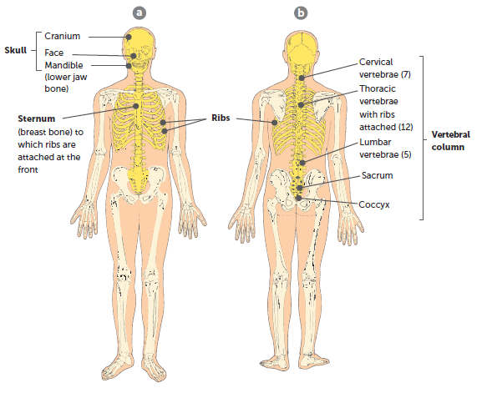
8.4 Overview of the skeletal system
Axial skeleton: a anterior view; b posterior view

Slide 16
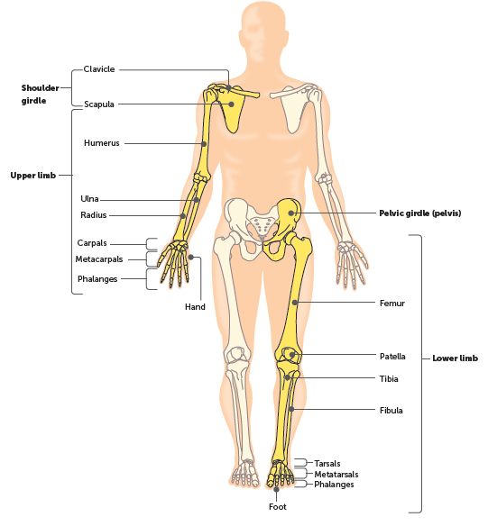
8.4 Overview of the skeletal system
Appendicular skeleton

Slide 17
8.5 Structure of bone and cartilage
Macroscopic structure of long bones
A long bone consists of:
Diaphysis – the shaft making up the main portion of the bone. The diaphysis is a hollow cylinder of compact bone surrounding a medullary cavity.
Epiphyses – the enlarged ends of the bone, covered with a thin layer of articular cartilage. The epiphyses have compact bone on the outside, but their central regions contain spongy or cancellous bone.
Periosteum – the dense, white, fibrous outer covering of the bone. There is no periosteum at the joints, where the bone is covered with an articular cartilage.

Slide 18
8.5 Structure of bone and cartilage
Microscopic structure of bones
Bone is classified as a connective tissue. Connective tissues consist of cells separated from each other by large amounts of non-cellular material called matrix. In bone, inorganic salts of calcium and phosphate are deposited in the matrix. These increase its rigidity and strength, and make it the hardest of the connective tissues.
Bone has a very complex structure.

Slide 19
8.5 Structure of bone and cartilage
Structure of compact bone
Compact bone consists of many similar units called osteons or Haversian systems that run parallel to the long axis of the bone. This gives the bone its maximum strength. Each osteon has:
a central canal (or Haversian canal) at its centre
concentric layers of bony matrix called lamellae surrounding the central canal
lacunae, which are small spaces in the matrix between the lamellae
a bone cell, or osteocyte, occupying each lacuna
tiny canals, known as canaliculi, running between the lacunae
projections from the bone cells entering the canaliculi and making contact with adjacent bone cells, allowing materials to be passed from cell to cell
at least one blood capillary, and possibly nerves and lymph capillaries, in the central canal of each osteon.

Slide 20
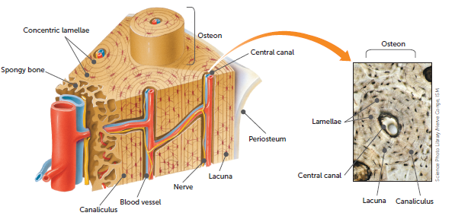
8.5 Structure of bone and cartilage

Slide 21
8.5 Structure of bone and cartilage
Structure of spongy bone
Spongy bone consists of an irregular arrangement of thin, bony plates called trabeculae. The bone cells occupy spaces in the trabeculae, and nerves and blood vessels pass through irregular spaces in the matrix.

Slide 22
8.5 Structure of bone and cartilage
Structure of cartilage
Cartilage is also a connective tissue. It contains numerous fibres made of a protein called collagen. These protein fibres are embedded in a firm matrix of a protein–carbohydrate complex called chondrin. This firm matrix enables cartilage to function as a structural support, while the presence of fibres gives cartilage a certain amount of flexibility. Because of these properties, it is found on the surface of bones at the joints, in the trachea and bronchi, and forms the nose, larynx and outer ear.
Cartilage has a firm matrix in which collagen fibres are embedded. Within the matrix are spaces that contain the cartilage cells called chondroblasts. These cells produce matrix and gradually become surrounded by it until they are trapped in small spaces called lacunae. Once this has occurred, the cells are considered to be mature and are referred to as chondrocytes.

Slide 23
8.5 Structure of bone and cartilage
Microscopic structure of cartilage
The collagen fibres in the matrix range from extremely fine to quite coarse. This variation in the fibrous structure of cartilage is used to classify it into three types:
Hyaline cartilage: contains many fine, closely packed collagenous fibres throughout the matrix. The fine fibres give the cartilage strength and flexibility. Makes up the rings of the trachea and bronchi.
Elastic cartilage: has conspicuous elastic fibres. It also contains collagenous fibres similar to those in hyaline cartilage, but they are not so closely packed. Elastic cartilage provides flexible elastic support in places such as the external ear.
Fibrocartilage: has a coarse appearance from the parallel bundles of thick collagenous fibres that make up this tissue. The fibres are not compacted as much as in hyaline cartilage, and therefore can be compressed slightly. Ideal for regions where the weight of the body is being supported or where there is a need to withstand heavy pressure, for example in the intervertebral discs of the spinal column, where it provides a cushion between the vertebrae.

Slide 24
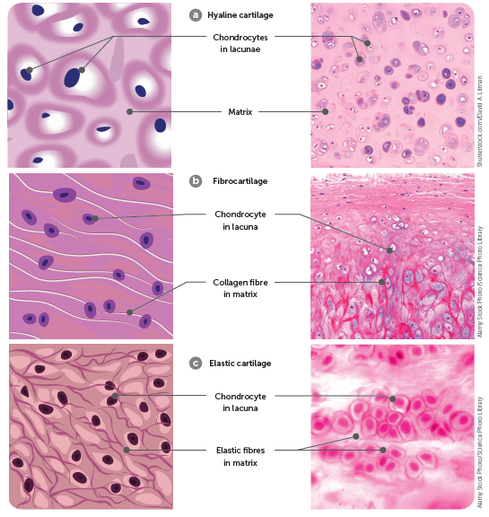
8.5 Structure of bone and cartilage

Slide 25
8.6 Movement of bones
Types of joints
Fibrous or fixed joints
When no movement occurs between the bones concerned, the joint is described as fibrous (or fixed or immovable). The bones are held in place by fibrous connective tissue, as is the case with the sutures of the skull.
Cartilaginous or slightly movable joints
Cartilaginous joints are held in place by cartilage, which allows slight movement to occur. The junction of the two pelvic bones (the pubic symphysis), joints between adjacent vertebrae, and the joints between the ribs and the sternum are examples of slightly movable or cartilaginous joints.

Slide 26
8.6 Movement of bones
Synovial or freely movable joints
Synovial joints are freely movable, with the amount of movement limited by ligaments, muscles, tendons and adjoining bones. They are categorised by the type of movement that occurs between the articulating surfaces of the bones.
Ball-and-socket joints form when the spherical head of one bone fits into a cup-like cavity of another.
Hinge joints allow movement in one plane only, much like that of a hinged door. They form when the convex surface of one bone fits into the concave surface of another.
Pivot joints are formed when the rounded, pointed or conical end of one bone articulates with a ring, formed partly by bone and partly by a ligament.
Gliding joints allow movement in any direction in a side-to-side or back-and-forth motion, restricted only by the ligaments or bony processes surrounding the joint.
Saddle joints are where two bones forming the joint are both saddle-shaped – that is, concave in one direction and convex in the other.
Condyloid (or ellipsoid) joints have one surface of bone slightly convex that fits into a slightly concave depression in another bone.

Slide 27
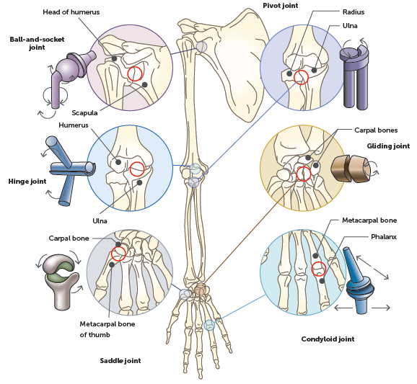
8.6 Movement of bones

Slide 28
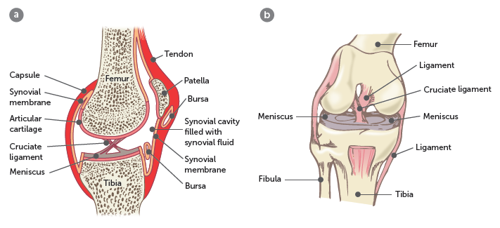
8.6 Movement of bones
Structure of a synovial joint
In a synovial joint there is a space, or synovial cavity, between the articulating surfaces of the bones. A synovial membrane surrounds the synovial cavity, and there is articular cartilage on the bone surfaces.
The knee joint, including the patella, is a typical example.
The knee joint: a in section, viewed from the side;
and b viewed from the front to show ligaments

Slide 29
8.6 Movement of bones
Keeping joints together
Several factors keep the articular surfaces of synovial joints together:
the fit of the articulating bones – for example, the way the head of the humerus fits into the socket of the scapula to form the shoulder joint
the strength of the joint ligaments holding the bones together – for example the hip joint
the tension provided by the muscles around the joint: in the knee joint, the fibrous capsule is formed principally from tendons attached to the muscles acting on the joint.

Slide 30
8.6 Movement of bones
Movement at a joint
Each joint is capable of specific types of movements.
Flexion and extension
Flexion, or bending, decreases the angle between the articulating bones, meaning the bones come closer together. For example, when the elbow is flexed, the lower arm (with the radius and ulna) moves closer to the upper arm (with the humerus).
Extension, or straightening, increases the angle between the articulating bones, moving the bones further apart. For example, when the knee is extended, the lower leg (with the tibia and fibula) moves further away from the upper leg (with the femur).

Slide 31
8.6 Movement of bones
Abduction and adduction
Abduction is movement away from the midline of the body. For example, lifting the arms upwards and away from the body is abduction; while movement towards the midline of the body is adduction (e.g. when returning the arms to the sides after abduction).
Rotation
Rotation is the movement of a bone around its long axis – for example, turning the head from left to right occurs due to rotation at the joint between the first two vertebrae.

Slide 32
8.7 Effects of ageing on the musculoskeletal system
Osteoporosis
If the loss of bone mass becomes sufficient to impair normal functioning, it is called osteoporosis. As bone density decreases, the risk of fractures increases so that even minor bumps or falls can result in serious fractures.
The bones most likely to be affected by osteoporosis are the vertebrae, ribs, pelvis, wrist and upper arm, although any bone can be affected.
To prevent osteoporosis, people need an adequate calcium intake in their diet, an adequate amount of vitamin D (either through exposure to sunlight or by dietary intake), and plenty of exercise.
Treatment for osteoporosis includes lifestyle changes to increase calcium intake, vitamin D production and exercise. Medication can sometimes be used to prevent or to treat the condition.

Slide 33
8.7 Effects of ageing on the musculoskeletal system
Osteoarthritis
Osteoarthritis is a gradual change in the joints that occurs over time and is frequently associated with ageing. However, other factors including irritation of the joints, wear and abrasion can also be involved. The joint cartilage deteriorates, and so the bone surfaces are no longer protected. The exposed bone begins to wear away and bony spurs or growths may develop from the exposed ends of the bone forming the joint. These growths and spurs decrease the space within the joint cavity, restricting movement of the joint.
The symptoms of osteoarthritis often appear in middle age, and almost everyone has some symptoms by the age of 70, but these symptoms may be minor.
There is no known cure, but treatment may include medication to relieve pain, physiotherapy to strengthen muscles around the affected joints, surgery to realign bones or joint replacement surgery.

